Slide 1
Geometric Design Process for the 21st Century – NCHRP Report 839
Timothy R. Neuman
Senior Associate
Bednar Consulting LLC

Slide 2
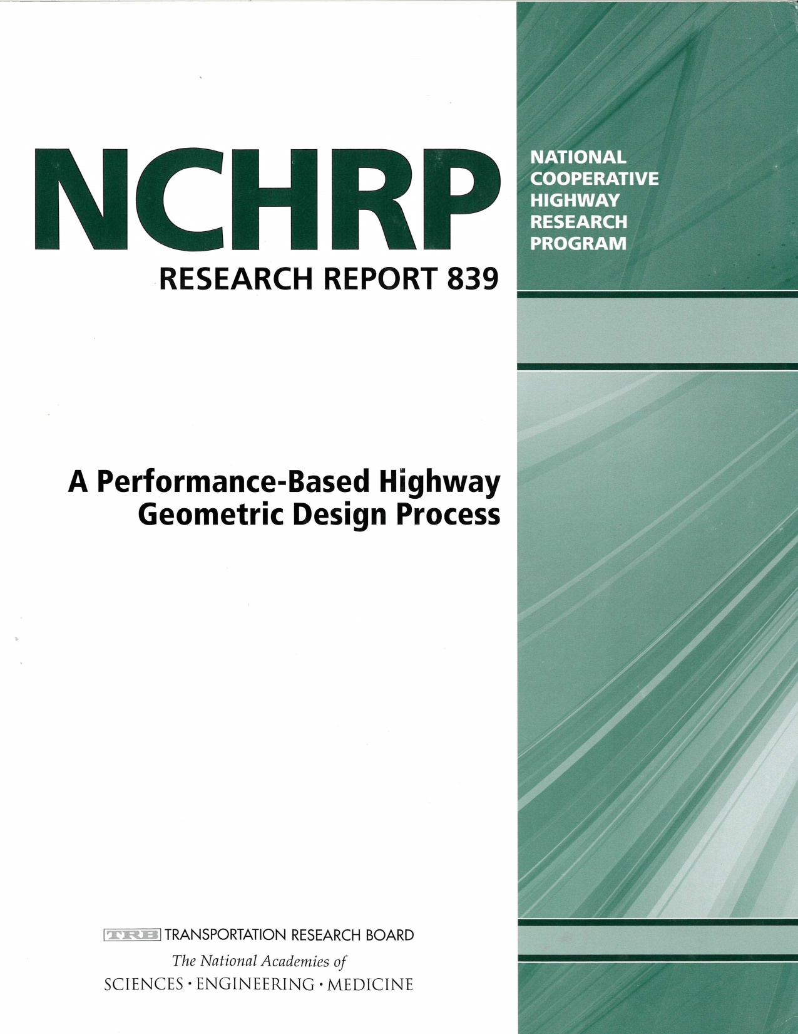

Slide 3
Project Team and Panel
Panel
Barton Thrasher
Anthony Buczek
Daniel Dulaski
James Gattis
Deanna Maifield
Peter Martin
Hugh McGee
Dennis Toomey
Ms. Lilly Shoup
Brooke Struve
Ray Derr
CH2M
Tim Neuman
Richard Coakley
Srikanth Panguluri
Richard Storm
MRI Global
Doug Harwood
Ingrid Potts

Slide 4
Introduction
NCHRP 15-47
An Improved Geometric Design Process
The recommended geometric design process reflects an understanding of:
History of highway design
Growth in knowledge of design effects on roadway performance,
Changes in emphasis and importance of road design and all road users
Legal framework that shapes implementation of public infrastructure,
Advances in technology that facilitate roadway design
Growing and seemingly permanent condition of limited resources for
  Construction
  Operation
  Maintenance of roads
Figure 5-1
Notes:
History of highway design
Growth in knowledge of design effects on roadway performance,
Research on operations and safety
Changes in emphasis and importance of road design and all road users
Peds
Bikes
Transit
Legal framework that shapes implementation of public infrastructure
regulatory requirements
Advances in technology that facilitate roadway design
Computer programs do the dimensional design faster
Growing and seemingly permanent condition of limited resources for
Construction
Operation
Maintenance of roads

Slide 5
‘During the past 60 years, transportation needs have changed and much has been learned about the relationships among geometric design, vehicle fleet, human factors, safety, and operations. AASHTO has continually updated its policies to respond to these changes, but such updates have provided limited changes to the fundamental process or basic design approaches…. An assessment of the current design process is needed to ensure that recent advances in knowledge (e.g., the AASHTO Highway Safety Manual) and emerging issues (e.g., complete streets, flexible design) are appropriately addressed.’

Slide 6
Early Research Findings
Important Insights for the Design Process | Alternative Design Processes and Initiatives
 | Complete Streets | CSS | Perfomance-Based Design | Practical Design | Design Matrix | Safe Systems | Travel Time Reliability | Value Engineering | Designing for 3R | Designing for VLVLR
Roads serve more than just motor vehicles | ● | ●
Road design involves many different disciplines | ● | ● | ● |  |  | ● |  | ● | ○
Context matters and it varies | ● | ● | ○ | ○ | ● | ○ | ○ | ○ |  | ●
Performance (operational, safety) is important |  | ○ | ● | ● | ● | ● | ● | ○
Performance may have many dimensions | ● | ● | ● | ● | ● |  | ● | ○ | ○
Safety performance should focus on elimination or mitigation of severe crashes |  |  | ○ | ○ | ○ | ● |  | ○ |  | ○
Speed and crash severity are closely linked |  |  | ● |  |  | ●
Existing roads with known problems are different from new roads |  |  |  | ● | ● |  |  |  | ● | ○
Traditional design approaches (full application of AASHTO criteria) are believed by professionals to yield suboptimal results | ● | ● |  | ● | ● |  |  | ○
Focusing on identifying and addressing the problem(s) should be central to developing design solutions | ○ | ○ | ● | ● | ● |  | ○ | ● | ○
Safety risk and cost-effectiveness are related to traffic volumes |  |  | ● |  | ● |  |  |  | ○ | ●

Slide 7
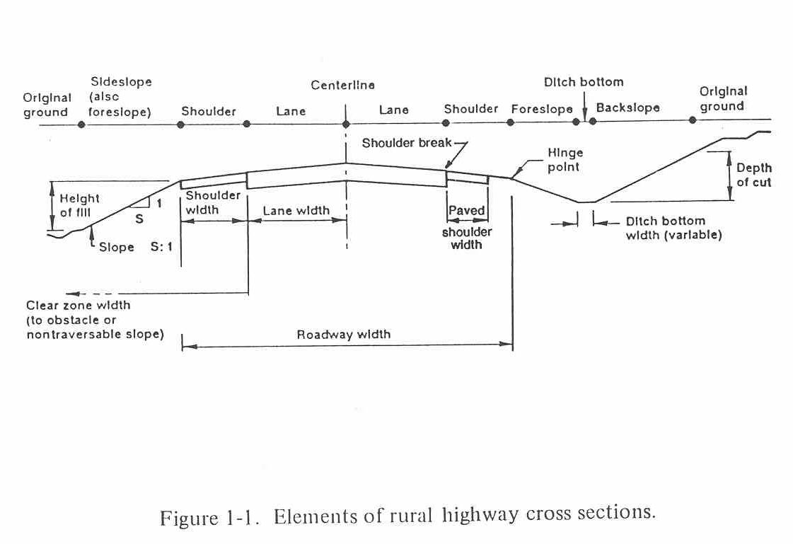
What is the purpose of geometric design? Of each of the elements of the road?

Slide 8
  Fundamental Bases for Roadway Design
Roadway design projects begin with a stated transportation problem. The purpose of geometric design is to provide the necessary three-dimensional framework for a facility to address the problem by providing the appropriate service to the users.
Dimensional and other design standards and criteria are a means to an end. The end is transportation performance, such performance to include mobility, accessibility, safety, and state-of-good repair.
Figure 5-1
Notes:
It should not be the goal of designers to design to standard – the goal is to provide a transportation facility with a good level of performance
Highway design criteria should be objectively related to one or more measures of transportation performance.

Slide 9
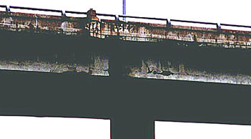
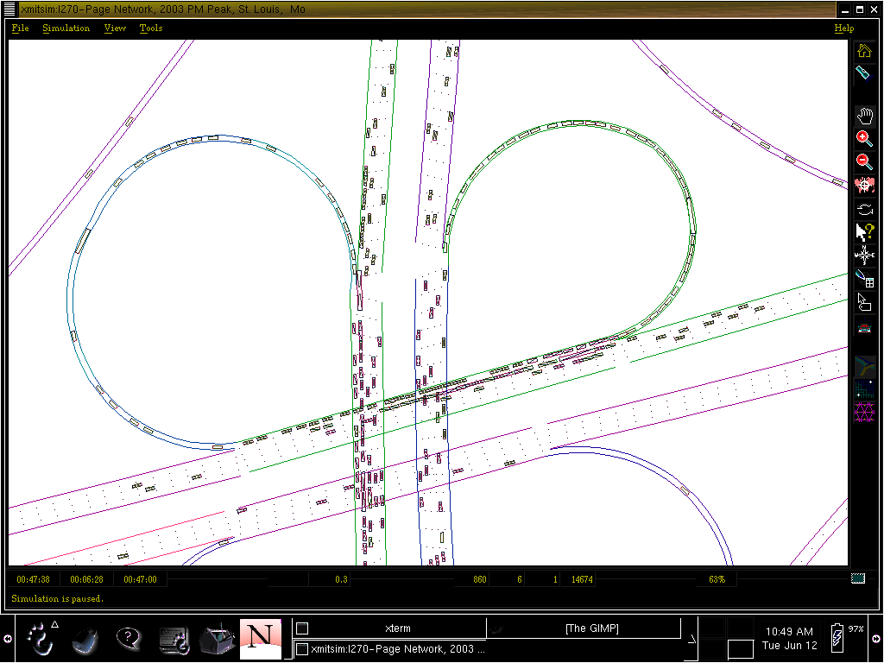
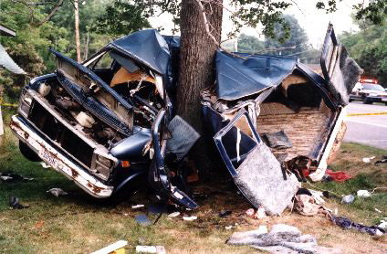
Solving objectively defined transportation problems is the reason for any and every project
Replacement of infrastructure in disrepair
Mobility or traffic operational problems; and accessibility
Safety problems (crash prevention and/or severity mitigation)
Notes:
This slide emphasizes that problems are and should be thought of and defined in meaningful, performance based terms. Such problems will generally fall into one of three categories – highway infrastructure in a state of disrepair, congestion or traffic operational problems (illustrated by a diagram showing a poorly performing weaving section at an interchange), or a safety problem.

Slide 10
Attributes of an Effective Geometric Design Process
Efficiently conducted
Scalable
Executed by properly trained professionals
Transparent to all stakeholders
Defensible
Figure 5-1
Notes:
The process must be efficient – with more needs and less funds available the process must be efficient and make the best use of the funds available
The process should be scalable – it must be applicable to projects and agencies both large and small
The process must be executable by properly trained professionals in a consistent manner – the process needs to be defined so it can be applied consistently.
The process should be transparent – stakeholders should feel that the process is a reasonable way to arrive at the best solution to the identified problems
The process must be defensible – the process needs to consider the liability concerns of the transportation agencies

Slide 11
Simplified Geometric Design Process
Figure 5-1
Notes:
Figure 22 illustrates a typical, simplified project development process that is modeled after many state DOT processes.
This framework for project development reflects the evolution of highway projects over the past 30 years
The importance of geometric design decision-making reflects on the accountability of the agency to its customers and to those providing the resources and funds.

Slide 12
      Recommended Highway Design Process
Step 1: Define the Transportation Problem or Need
Step 2: Identify and Charter All Project Stakeholders
Step 3: Develop the Project Scope
Step 4: Determine the Project Type and Design Development Parameters
Step 5: Establish the Project’s Context and Geometric Design Framework
  Framework for Geometric Design Process – New/Reconstruction
  Develop Project Evaluation Criteria w/in Context Framework
  Establish Decision-making Roles and responsibilities
  Determine Basic Geometric Design Control – Design or Target Speed
  Determine Basic Design Controls
    Design Traffic Volumes, Design LOS, Road User Attributes
Figure 2-4
Notes:
In the report we discuss 11 steps to the recommended design process
A few of the most important are highlighted
Working with stakeholders will continue to be more important

Slide 13
      Recommended Highway Design Process
Step 6: Apply the Appropriate Geometric Design Process and Criteria
Step 7: Designing the Geometric Alternatives
Step 8: Design Decision-Making and Documentation
Step 9: Transitioning to Preliminary and Final Engineering
Step 10: Agency Operations and Maintenance Database Assembly
Step 11: Continuous Monitoring and Feedback to Agency Processes and Database
Figure 2-4
Notes:
The PDP moves through a series of major steps. Every project begins with the identification of issues. Safety is nearly always an important need, regardless of stated project needs, and it is often a common value among disparate stakeholders. Some projects may be driven by safety issues. Although some projects are not directly driven by a safety issue, safety performance may be affected by or may even influence the actions taken to address the primary issue.
At all levels of project development, substantive safety can be used to inform the process and to facilitate better transportation decisions.

Slide 14
Geometric Design Context and Framework (Step 5)
Current AASHTO Policy
Functional Classification (3)
Urban/Rural (Land Use)
Terrain (3)
Design Vehicles
Design Year Traffic
Project Types (2)
  New Construction & Reconstruction
  3R
Proposed Framework
• Functional Classification (5)
• Land Use / Context Zones (6)
• Design Users
• Design Traffic
  - Design Year
  - Service Life
• Project Types (3)
  - New Construction
  - Reconstruction
  - 3R
Notes:
Current AASHTO design policy addresses the context in just two dimensions, characterizing location as urban or rural, and terrain as level, rolling, or mountainous. This framework has been in place since the first versions of the AASHTO Policies in the 1950s. It is based primarily on motor vehicle operational needs and the costs and practicality of project implementation for roads on new alignment in differing area types and terrain.
A much more robust framework is needed that further differentiates important external controls on appropriate geometric solutions. The need for a more robust framework is primarily associated with the need to tailor the geometric design process for contexts in which multi-modal travel, and in particular pedestrian and other vulnerable user mobility and safety, should be the predominant concern.

Slide 15
Roadway Context Zones
ITE Designing Walkable Urban Thoroughfares: A Context Sensitive Approach
Notes:
A current model for converting land use into useable context definitions for a geometric design framework is that developed in the Institute of Transportation Engineers (ITE), Designing Walkable Urban Thoroughfares: A Context Sensitive Approach –ITE Recommended Practice
The more nuanced context definitions better reflect the range of land uses, and most importantly, address the expected presence of and unique requirements associated with pedestrians and bicyclists.

Slide 16
Characteristics of Severe Crashes by Context Zone
Notes:
The importance of a more robust context zone definition is illustrated in these figures.
The research team performed an analysis of the safety performance of roads in Cook County, Illinois (which includes the City of Chicago) using the context zone definitions in the previous Figure.
Within Context Zones 1 and 2 the primary transportation modes are motor vehicles – both passenger cars and trucks. Context zone 1 may include special vehicle types associated with the nature of the land use. These may include logging or other resource recovery trucks, recreational vehicles including towed carriers for boats and other equipment, and bicycles. Although pedestrians are not excluded, their presence in context zones 1 and 2 is typically of sufficient rarity that their presence does not create special roadway design demands.
Context zone 3 has sufficient development by type and density such that non-motorized road users are present with some regularity. As such, the design and operation of the roadway must consider their presence. In the suburban environment the primary operational concerns remain the movement of vehicles, but 1) transit buses may be present; 2) pedestrians crossing major intersections are a concern; and 3) bicycle traffic may be present, particularly where such routes serve or are adjacent to land uses such as schools and parks.
With context zone 4 land use type and density progress to more urban forms. Pedestrian travel within the right-of-way should be expected, including the crossing of pedestrians at intersections. Intersection frequency may be greater, driveways more prevalent, and in some cases on-street parking common or necessary to support the adjacent land use. Within this context zone buses and trucks also operate, with many of the latter supporting retail and commercial development. Because of the prevalence of pedestrian activity, traffic operations in context zone 4 should emphasize lower speeds to minimize both the frequency and severity of vehicle/pedestrian conflicts.

Slide 17
Characteristics of Severe Crashes by Context Zone
Notes:
With context zones 5 and 6, the land use types and density are pure urban form. The street environment serves high volumes of pedestrians. Transit is prevalent and may be the most significant vehicular element. Trucks and freight vehicles are present to serve the commercial land uses, but their operations may be restricted to off peak time periods. Within these context zones, road design issues typically include allocation of cross section and intersection design. Intersection design and operations should favor the safe accommodation of pedestrian travel. This may mean limiting the use of turning lanes, provision for pedestrian only signal phasing, and signal progression that produces very low speeds. Within these zones the concept of LOS for vehicles as classically understood does not apply.
The substantive risk profile as it relates to road users and crash type throughout the road network is highly sensitive to context. Design policy and process in its formulation and application should be adapted to provide appropriate focus, design controls, dimensions, and approaches that address the unique and differing inherent risks associated with each type of roadway in each of the land use contexts.

Slide 18
Critical Substantive Safety Issues by Context Zone and Functional Class of Road
Notes:
Based on the analysis done for the Chicago area in Figure 27 and other information contained in the AASHTO HSM, a safety performance framework is evident to guide the thought process and priorities of design engineers. This is shown in Figure 29.

Slide 19
Traffic Operational Issues Vary by Context Zone and Functional Class of Road
Notes:
Figure 28 describes the functional operational needs, values, and road user types associated with each cell in the basic framework. Functionality ranges from accessibility to mobility; with the latter further described by reliability. Road users for which the design should routinely serve range from one vehicle type (for special purpose roads), to motor vehicles only, to the full range of users including vulnerable road users.

Slide 20
Geometric design approaches and solutions should be ‘context sensitive’
Apply appropriate performance measures and benchmarks
Incorporate local costs and impacts
Address regulatory and environmental considerations
Respect stakeholder inputs

Slide 21
Project Types and Transportation Problems
Notes:
Figure 24 demonstrates the range of possible problems associated with the three project types. A project on new location will always involve addressing a mobility problem, accessibility issue, or both. An important process step for new location projects is a full stakeholder discussion and agreement on how the travel modes will be accommodated, including motor vehicles, freight, transit, pedestrians, and bicycles.
Confirming and potentially expanding the problem definition based on stakeholder input is a key process step. A 3R project may proceed with additional features added without changing the basic project definition or purpose of the project. But depending on the project specifics and additional problems suggested, the scope of the project, applicable type, and design approach may significantly change.
An effective and responsive highway design process resolves problem definition and designates the appropriate project type early in the process.

Slide 22

Design Standards and Problem Definition
The presence of one or more geometric design features that fail to meet current design criteria is NOT a transportation problem….
It is merely a condition of the context of a reconstruction or 3R project.
‘Upgrade to current standards’ is NOT an appropriate purpose and need
Notes:
Reconstruction and 3R
Why spend funds to upgrade to a standard that will not address a problem with the efficiency or safety in the operations?
This allows designers to focus on solving problems

Slide 23
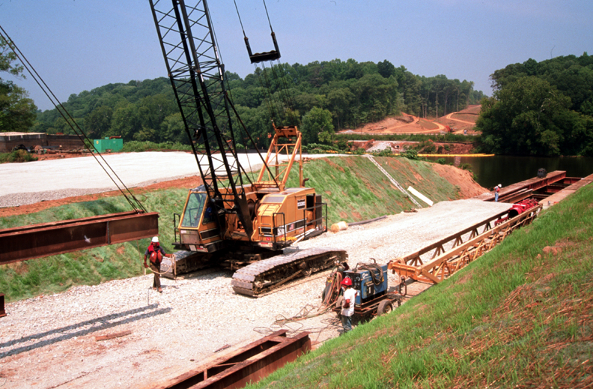
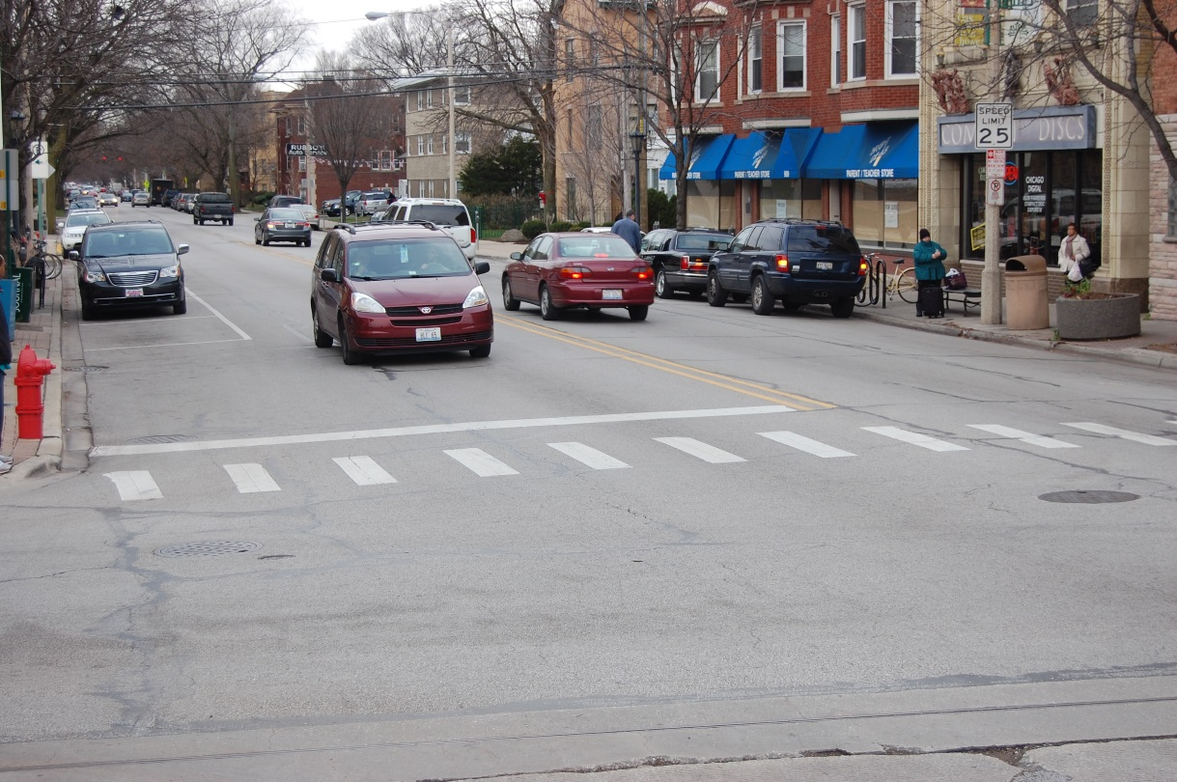
New Construction vs reconstruction
Notes:
New roads or projects on new alignment are different from other project types. First, a new road is typically built to address problems of access and/or mobility only (and not to address an existing safety problem). New roads will substantially change the surrounding land use. In many cases, such changes are not only positive but intentional. Providing access to land creates development opportunities. Segmentation of large parcels such as agricultural land changes the economics and potential value of such lands. Existing regional and local travel patterns will substantially change, as the new road presents re-routing opportunities.
Forecast traffic volumes and travel patterns are inherently more uncertain for new roads. Travel behavior including speed, crashes, and conflicts may be estimated based on tools and models, but the actual route choices of potential users are unknown prior to opening of the road.

Slide 24
New Construction vs. Reconstruction
New Construction
• Unknown Safety
Performance
• Unknown Operational
Performance
• Available R/W of Sufficient
Width
• Minimal Impacts to Adjacent
Development
• Construction Costs are
Quantity Based
Reconstruction
• Known Crash History
• Known Operational
Performance
• Known Limited R/W
• Adverse Impacts to
Adjacent Development
• Maintenance of Traffic /
Local Access Drive
Construction Cost
Notes:
By definition, a reconstruction project involves a roadway already in place and functioning. Similarly, a new construction project (one on new alignment) introduces a new transportation corridor where none exists. The following differences are evident:
• With an existing road, the abutting land use has developed around the mobility and access provided by the road; with a road on new alignment the road itself always produces significant change (positive and potentially negative).
• With an existing road, there is a clear and well-understood operational and safety performance history; none exists for a road on new alignment.
• The costs of construction and constructability of each project type are based on significantly different factors.

Slide 25
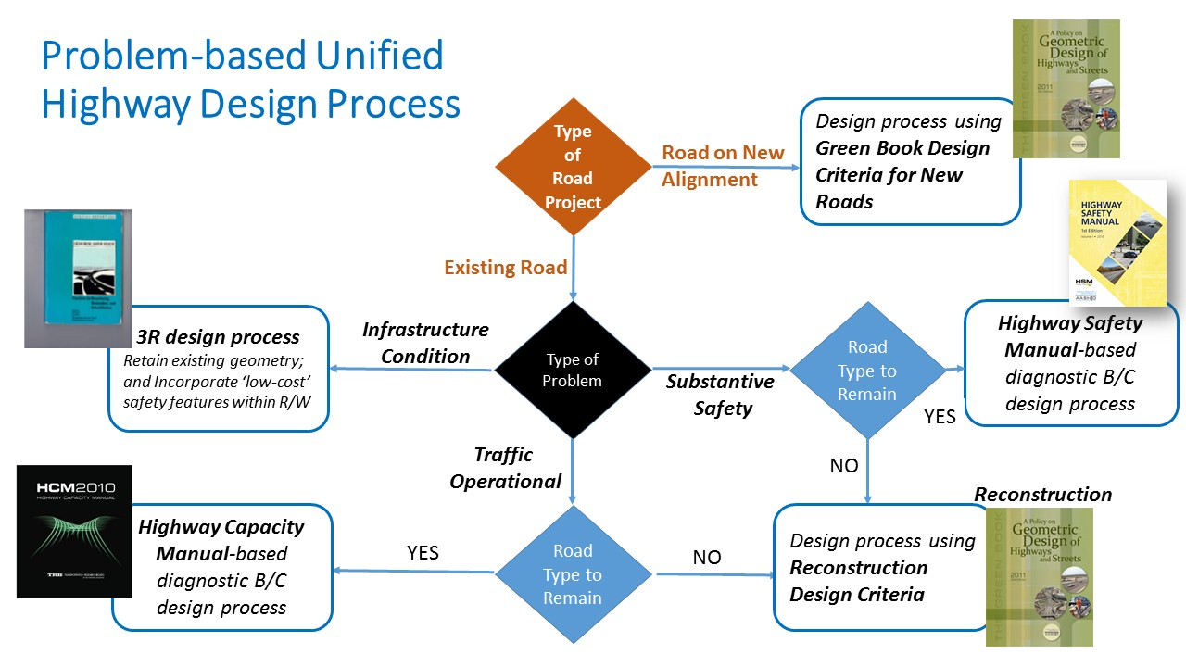

Slide 26
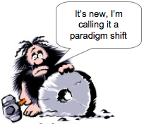
Paradigm shifts are in order…..

Slide 27
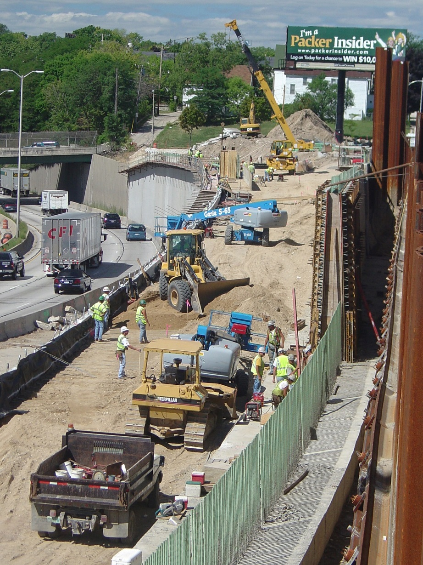
Proposed Reconstruction Design Process
Benefit/Cost Analysis Based (crash and/or operational and travel time; implementation costs)
Context specific
Incorporate service life
Incorporate operations and maintenance costs

Slide 28

Reconstruction project decisions should employ a Benefit – Cost Framework
User Benefits
  Travel Time Savings
  Crash Reduction Costs
Agency Costs
  Construction Costs
  Annual Maintenance Costs*
  Terminal Value
Projects should be evaluated over a Service Life that is much longer than the Design Life

Slide 29
Basic Design Controls
Design Year Traffic
Service Life Traffic
Design or Target Speed
Design Operating Conditions
  Design Level of Service
  Travel Time Reliability
Road User Attributes
Notes:
Design Year Traffic
Service Life Traffic
Design or Target Speed
Design Operating Conditions
Design Level of Service
Travel Time Reliability
Road User Attributes

Slide 30
Service Life
Process should acknowledge that the facility will last much longer than the design year
Project Type | Service Life of Infrastructure
3R (Pavement Resurfacing) | 20 to 30 years
Roadway Reconstruction | 75 to 100 years
New Alignment Roadway | 75 to 100 years
Bridges, Walls, and Related Infrastructure | 50 to 75 years
Major Watercourse Crossings | 100 years
Notes:
A historic anomaly of the geometric design process is the disconnect between the nominal forecast design year (typically 30 years or less) and the expected useful physical life of roadway infrastructure. Right-of-way, road grading, storm sewer, and structural elements have practical service lives of 75 years or more. A current trend in pavement design is for longer-lasting pavement—up to 50 years or more. Major river crossings such as tunnels or long span bridges are designed assuming at least 100 years of life. These much longer functional lives conflict with the much shorter timeframes for which design year traffic is typically developed.

Slide 31
Design Exceptions
‘Doing the right thing’ may require a design exception under current policy guidance
If design exceptions are done routinely, what does that tell us about the validity of the underlying design standard or model?
If the problem is solved with it operating safely and efficiently, does it matter if it meets a dimensional criteria?

Slide 32
Each project is uniquely designed to reflect the context
Cost effectiveness is directly embedded in the solution
No design exceptions – the right answer is what it is
Agencies should be spending less on projects than they do now
Implications of the proposed reconstruction design process
Notes:
Implications of the proposed reconstruction design process
Each project is uniquely designed to reflect the context
Cost effectiveness is directly embedded in the solution
No design exceptions – the right answer
Agencies should be spending less on projects than they do now
Not meeting standards is not a problem

Slide 33
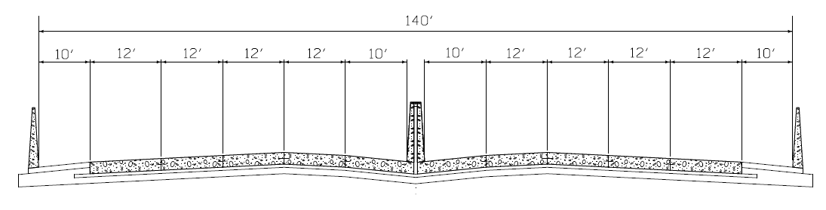
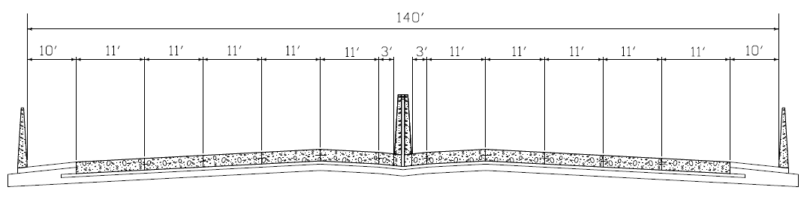
Case study comparison of four lane standard and five lane reduced width cross sections
Alternative 1:
4 – 12 ft lanes with 10 ft right shoulders and 10 ft left shoulders
Alternative 2:
5 – 11 ft lanes with 10 ft right shoulders and 3 ft left shoulders

Slide 34
Case study comparison of four lane standard and five lane reduced width cross sections
Alternative | Capacity Analysis results
 | Level of Service | Density (pc/mi/ln) | Speed (mph)
1 | F | 61.3 | 43.7
2 | E | 35.5 | 60.5
LOS was determined using HCS 2010 Freeways Version 6.60
Alternative | Predicted Crashes per mile per year
 | Total | K | A | B | C | PDO
1 | 46.8 | 0.2 | 0.6 | 3.2 | 9.7 | 33.2
2 | 40.1 | 0.3 | 0.6 | 3.5 | 8.1 | 27.7
Predicted crashes were determined using ISATe (Build 6.10) (uncalibrated model without crash data input)

Slide 35
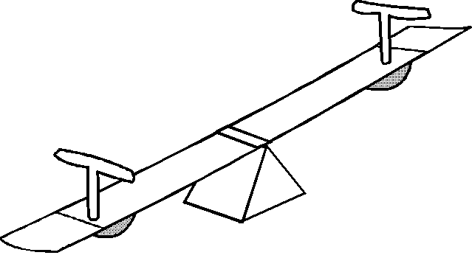
      The Future of Geometric Design
Lessened time, effort and expense to complete the design in steps 6 - 9 (per advances in design technology)
Greater effort to engage stakeholders, test and evaluate design effects and apply complex decision processes involving trade-offs (steps 1 – 8)
Figure 2-4
Notes:
The PDP moves through a series of major steps. Every project begins with the identification of issues. Safety is nearly always an important need, regardless of stated project needs, and it is often a common value among disparate stakeholders. Some projects may be driven by safety issues. Although some projects are not directly driven by a safety issue, safety performance may be affected by or may even influence the actions taken to address the primary issue.
At all levels of project development, substantive safety can be used to inform the process and to facilitate better transportation decisions.

Slide 36
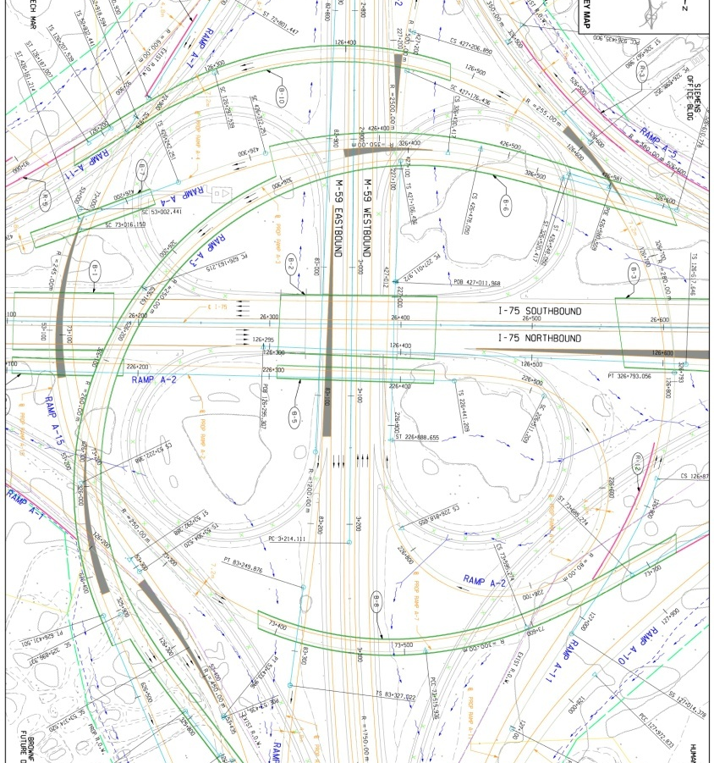
Geometric design is much less labor and time intensive
Advanced computer aided design technologies enable
Rapid testing of alternative design solutions
Quality control
Constructability reviews
Cost estimating

Slide 37
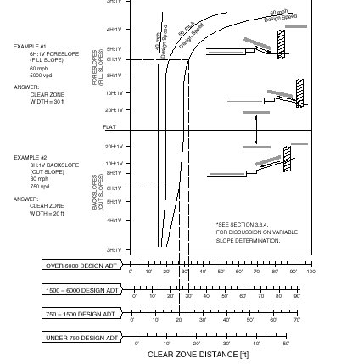
Recommendations for revised approach to geometric design criteria for roads on new alignment
Established dimensional criteria are still needed for roads on new alignment and new roads on existing R/W
AASHTO criteria in need of improvement
  Sight Distance
  Horizontal Curvature
  Lane Widths

Slide 38
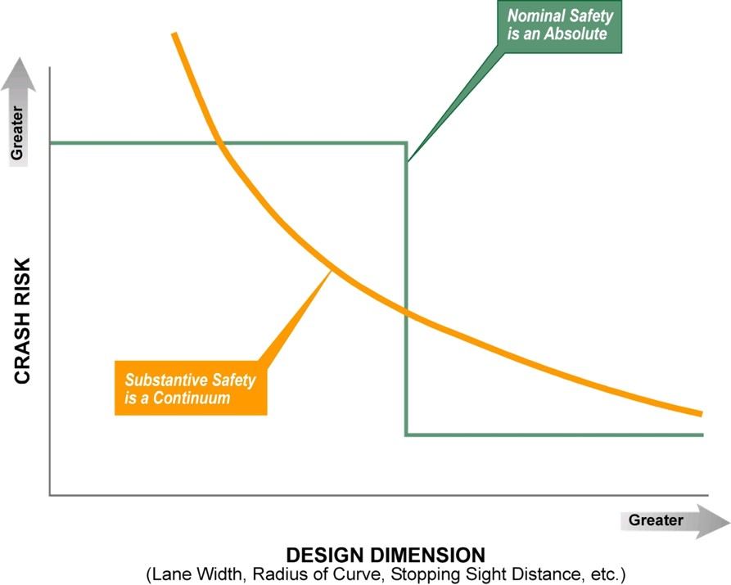
Nominal vs. Substantive Safety – The conundrum of geometric design criteria

Slide 39
Geometric design criteria for new roads should reflect cost-effectiveness principles and be more ‘context sensitive’
Functional models require a new look
Models may need to vary by road type and context
Criteria should include traffic volume (relative safety risk)
Criteria should incorporate known safety relationships

Slide 40
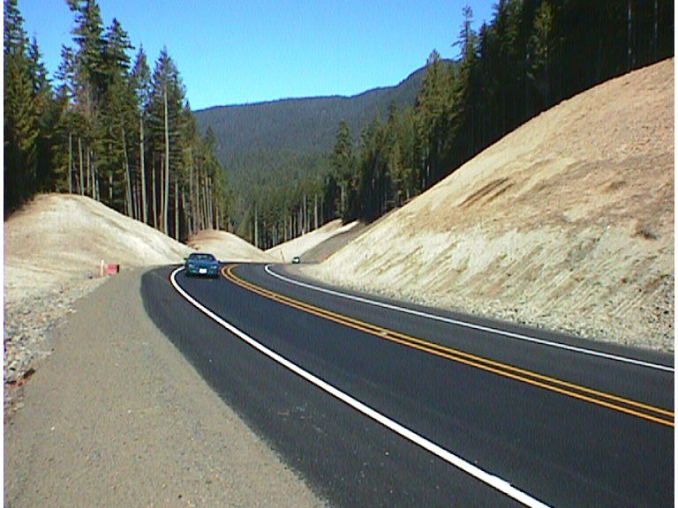
The AASHTO horizontal curve design model
e + f = V² / 15R
where
V = design speed (mph)
R = radius of curve (ft)
e = superelevation
f = design side friction
AASHTO Design Assumptions
Passenger car tracks the curve as a point mass
Passenger car operates at constant design speed through curve
‘f’ values reflect driver comfort
Curve design should avoid loss of control due to skidding (i.e., during cornering)
Applies to all functional classes and volume ranges
Notes:
Let’s look at the AASHTO curve model and all its inputs --
The instructor should walk through each variable; may need to explain briefly what superelevation is.
On the right side of the slide are the implied assumptions a designer follows when he/she uses the AASHTO model. (Animation is built in, delaying the right side).
The instructor should emphasize that curve design is ‘driven’ by an operational model (not a direct accident -based model) of presumed or selected desirable behavior.

Slide 41
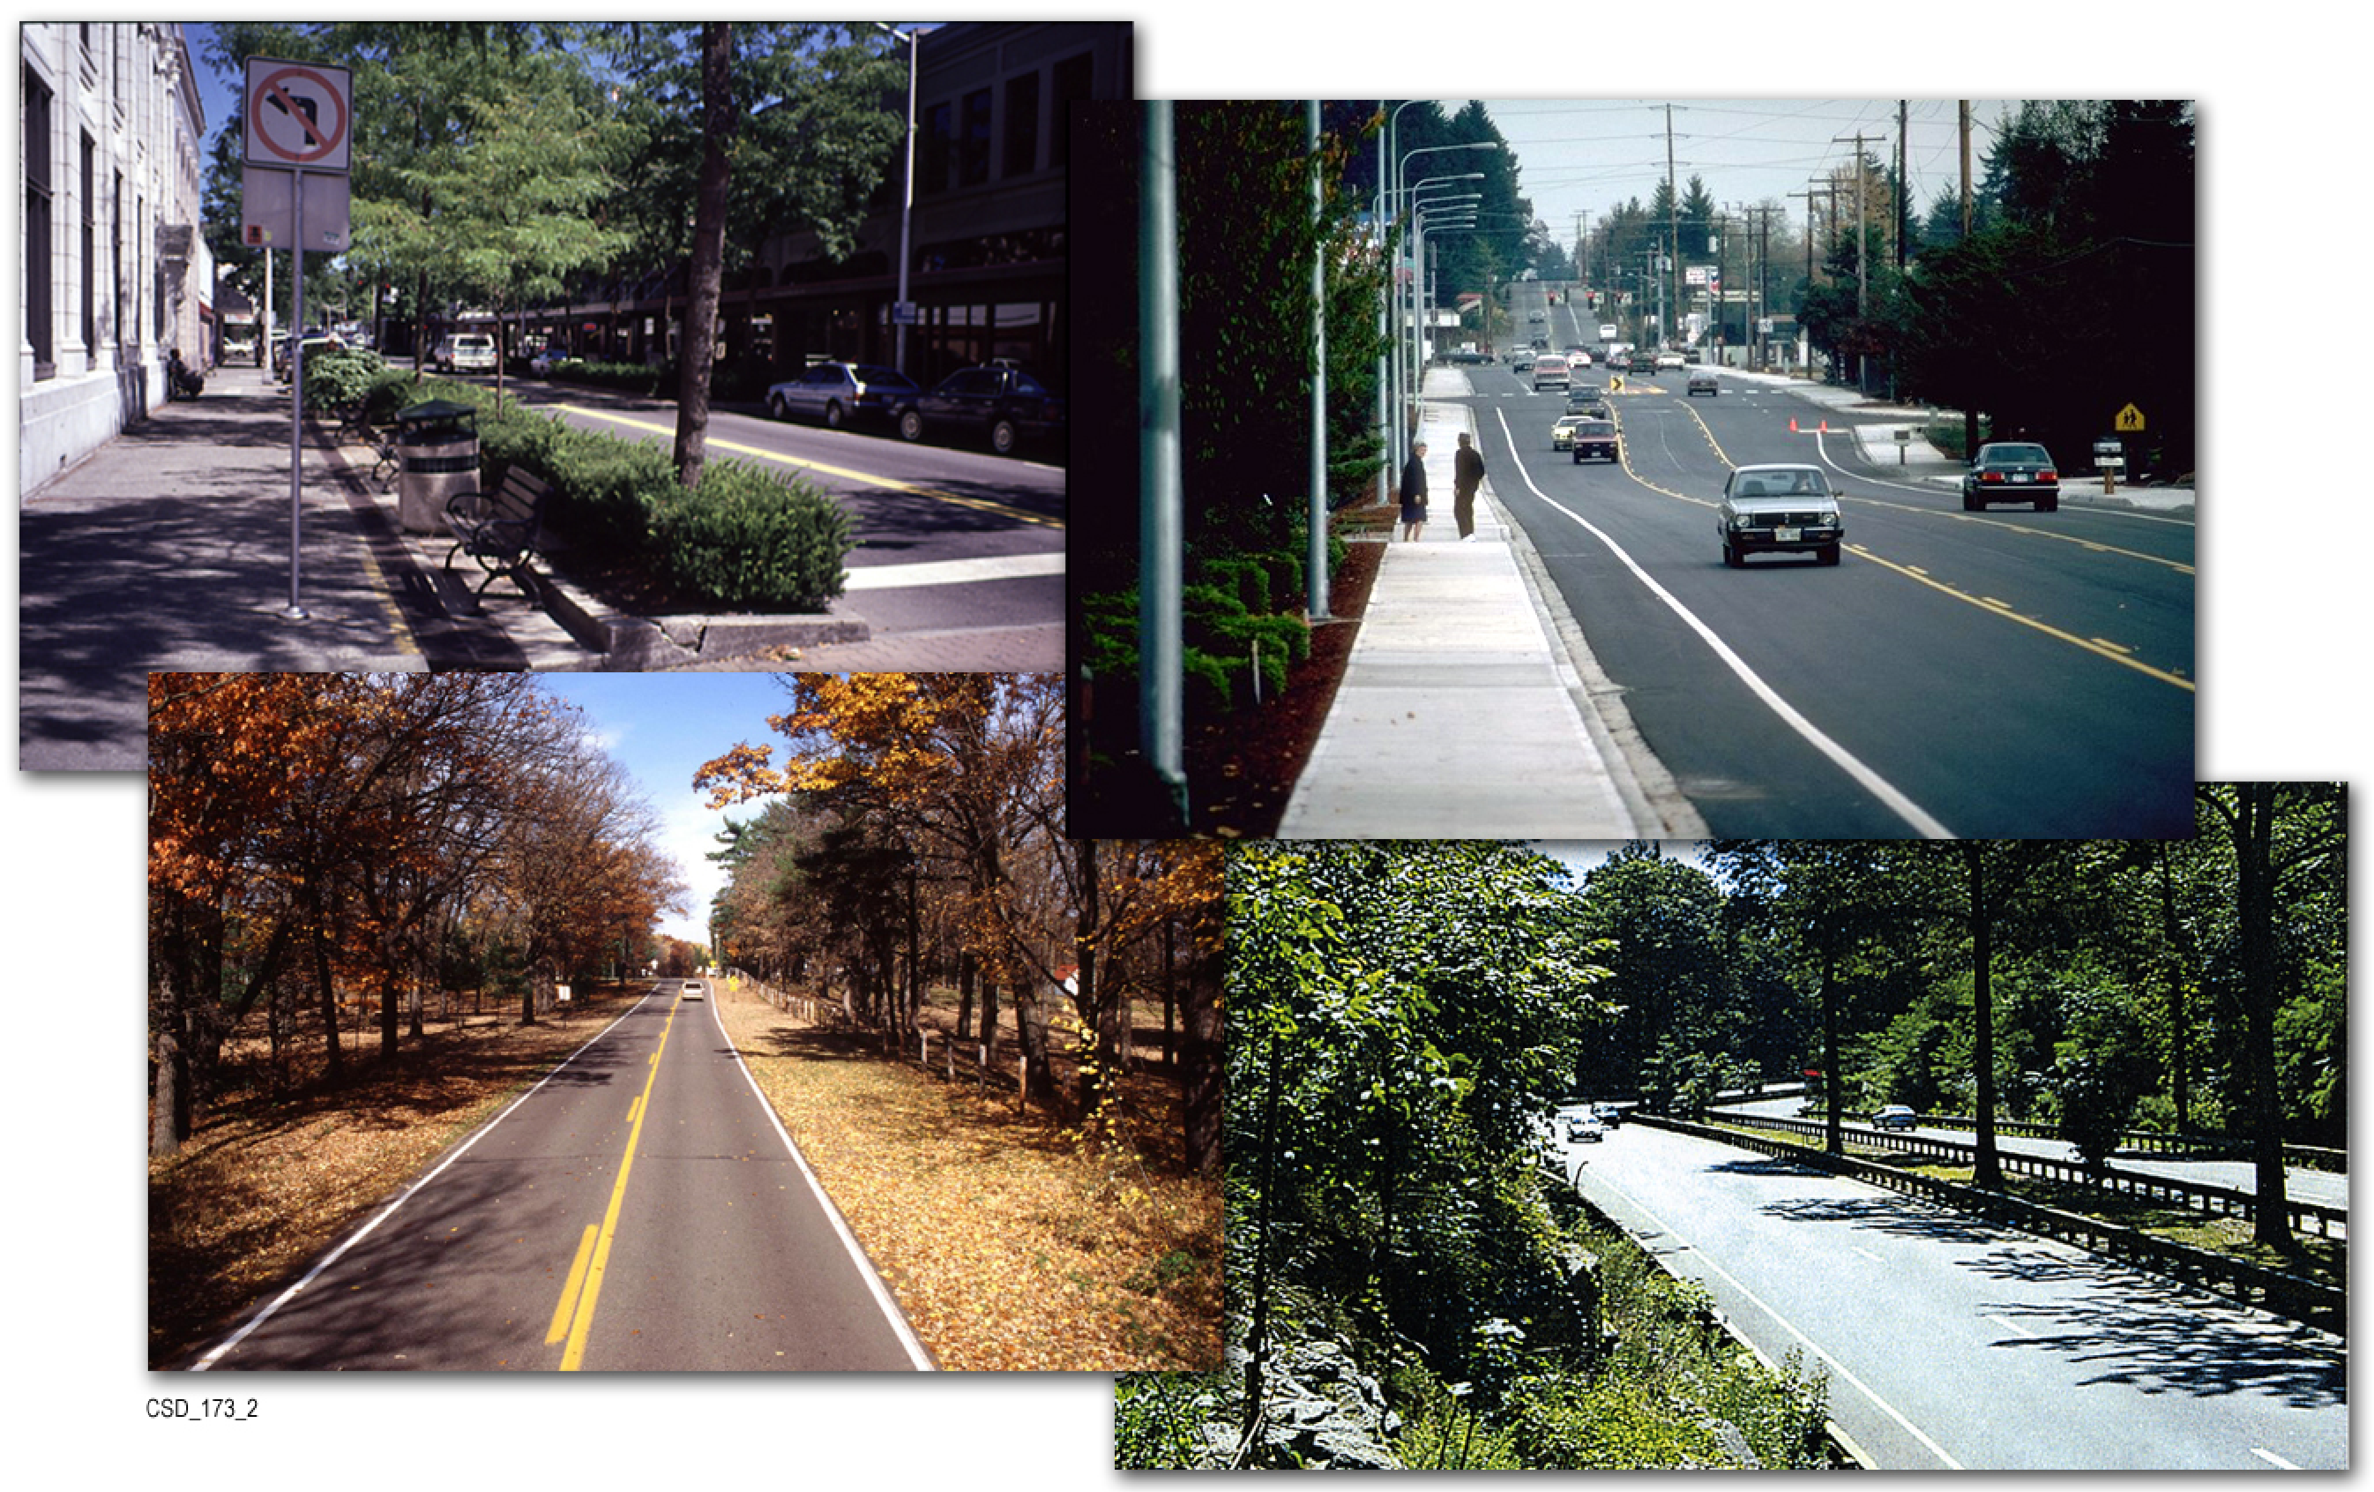
Does the simple AASHTO curve model make sense for all project contexts?
What about safety performance?
What about other vehicles such as trucks, buses, emergency equipment, recreational vehicles, etc.?
How important is comfort vs. other operational conditions?
What about other performance criteria (e.g., off-tracking)?
What about interactive effects of other criteria (grade, width, roadside)?

Slide 42
Strawman Framework for Design of Horizontal Curvature for Road Types by Context
Notes:
Depending on context and road type the approach varies
Urban zones/local streets – fire trucks, delivery vehicles – off-tracking

Slide 43
Potential approaches to horizontal curvature design criteria

Slide 44
Strawman Framework for Design of Lane Widths for Road Types by Context

Slide 45
Transition in skills, knowledge and approach
The ‘old model’ designer
The ‘new model’ designer
Engaging multiple stakeholders (some non-technical)
Proficient in application of tools, models and evaluation methods for operational and safety effects of design (HCM, HSM, IHSDM)
Always testing multiple alternatives
Able to design in range of speed and land-use contexts
Fully knowledgeable in environmental regulations, laws, and processes
Applying multi-attribute decision models
Knowledgeable in economic analysis; B/C principles
Understands basics of vehicle-centric AASHTO models
Applying the policy and standards to produce a solution that fully meets criteria
Calculation of alignment
Balancing of earthwork
Detailing of construction plans
Compiling quantities for contract documents

Slide 46
Contents of Future Green Books
New Construction Design Criteria
  Performance-based (proven crash and/or operational and travel time relationships)
  Sensitive to traffic volume
  Varies by road type
  Sensitive to context
  Incorporate Service Life
  Incorporate known operations and maintenance relationships
Reconstruction Design Process
  Benefit/Cost Analysis Based (crash and/or operational and travel time; implementation costs)
  Context specific
  Incorporate service life
  Incorporate operations and maintenance costs

Slide 47
Final Report
Documents the findings
Performance based critique of Green Book
Includes detailed outline for a new Green Book
Provides case studies demonstrating the process
Research recommendations for new construction criteria

Slide 48
Questions
timneuman.engineering@gmail.com

